Slide 1
Facial Recognition and Smart Card Scanner
Submitted in the partial fulfillment for the award of the degree of
BACHELOR OF ENGINEERING
IN
COMPUTER SCIENCE AND ENGINEERING
Submitted by:
Gunit Kumar Bedi - 19BCS3552
Yash Jain - 19BCS3553
Akhilesh Sharma - 19BCS3555
Shishir Kumar Verma - 19BCS3560
Tanvi Dhimaan - 19BCS3546
Under the Supervision of:
Dilpreet Kaur Arora
Department of AIT-CSE
DISCOVER . LEARN . EMPOWER

Slide 2
Outline
Introduction to Project
Problem Formulation
Objectives of the work
Methodology used
Results and Outputs
Conclusion
Future Scope
References

Slide 3
Introduction to Project
1. Problem Definition: With a sudden boom in technology, we discovered many things like its benefits, multiple vulnerabilities, usage of it in our daily life. As it is part of life so we cannot let it be vulnerable, we need to secure it, so no one can exploit it. So, this project came into action as it is based on 2-layer protection/security.
Today security is one of the most essential parts. As everyone of us wants their data and stuff to be secure, we have lately seen so many data breach around the globe in the biggies like Twitter, Jubilant Food Works Ltd their information been stolen and there are multiple cases of access to the places where an unauthorized person have breached through, such big data breach is not possible without internal help so the unauthorized employee can be a threat, if we want to secure the confidentiality we have to work on availability of that information to some authorized people in the industry and a security system strong enough to differ between authorized and unauthorized person, and it's a system with the lowest vulnerability possible.

Slide 4
Introduction to Project
2. Project Overview:
This project is a solution for problems related authorization, availability and theft. In this project we will be working on a facial recognition system which will give access to the authorized user in the system or the lab and this facial recognition data will be managed by admin. Admin will be provided with a GUI based software easy to use and a database to enter user’s information related to its job, status and personal information, multiple pictures with different angles will be stored and from that system we will also generate a QR(quick response) code that will be provided on the ID card of the user with that you can get users information and also it is the second layer of protection after facial recognition the user have to scan its card to get entry into the secured lab. Users would not have access to the admin system. User data will be stored and managed by Admin and any new user will be admitted in a day and they will be provided with a smart card in 2-3 days.
It is the safest system to use for securing your office, lab or working area from theft, accessibility, authorisation and confidentiality of the information that should not be leaked.

Slide 5
Introduction to Project
3. Software Specifications:
a. OpenCV (open-source computer vision library) it is a software which include all the libraries regarding machine learning and computer vision development in which we are using Haar-cascade for facial recognition and QR code we are using myqr module, and all of this will be developed in Python language.
b. VS-Code (Visual studio code) is an integrated development environment made by Microsoft for Windows, Linux and macOS. Features include support for debugging, syntax highlighting, intelligent code completion, snippets, code refactoring, and embedded Git
4. Hardware Requirements: Along with software requirements, the project has some hardware requirements as well for complete working of the project.
Webcam : for using facial recognition, and capturing faces.
Processor : Pentium IV with 800 MHZ Clock speed (at least)
RAM/Memory : 2GB (minimum)
Hard disk/Storage : 40GB
Network Interface card : 32bit PCI/ISA Ethernet or Latest

Slide 6
Problem Formulation
Data is an important asset of an organisation as well as an individual. In the era of technology and science it is a popular saying that nowadays wars are not won by large armies and weapons, but by the information gathered about the enemy and enemy’s moves.
So with this, it is important to store out confidential and important data in a very secure manner with the maximum security possible. With securely storing the data it is also very important the data stored should be easily available and to the authorised only.
For this the password and usernames came into being. But it has been noticed that the login credentials of the users can be hacked using techniques like social engineering and brute forcing with the help of some personal information of the user.

Slide 7
Problem Formulation
This is also a matter of concern that the password for the users can very easily be compromised but at the same time biometrics can’t. Biometrics like retina, face, fingerprint are unique to every one. So the approach of replacing passwords with face recognition and usernames with unique QR codes has been tried. In this approach the user needs not to enter the login credential but to scan a unique allotted QR available on his/her card as his username and recognizing his/her face as the password.

Slide 8
Objectives
The main objective of this system shows how we can make our workplace, Labs, and confidential places safe from theft of information or unwanted availability of the data, by just using some algorithms and libraries and using hardware like webcam and QR code scanner. And are explained as follow:
We are using OpenCV for the application of libraries and algorithms.
Implementing Haar-cascade algorithm for facial recognition and myqr module for QR code generation and .
Created an admin database which is easy to use and only be accessed by admin.
For facial recognition we will be taking multiple pictures about 20-30 with different lighting and it will give the best output .
For QR code generation we will convert the personal information data into the QR.
To enter, the user needs to pass the 2 layers of authentication firstly the facial recognition and then the smart card.
Whenever any user enters the premises the admin will get instant information about the user who entered.

Slide 9
Methodology used
Face Detection
In the field of technology Face detection is treated as the demanding and practically applied approach. The identification of each face present in an image is the major task of the face detection. Here the implementation is done using OpenCV.
Loading the input images.
Converting the input images into grayscale image images.
Applying the Haar cascade and LBP classifier.
Comparing both classifiers based on the accuracy and time.
Importing the required libraries.
Taking the images which are captured by the camera.
To process the image through the classifiers it is converted into a grey scale image.
Image will be loaded using OpenCV
By default, image will be loaded into BGR colour space

Slide 10
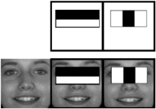
Methodology Used

Slide 11
Methodology used
Haar Cascade Classifier
Loading the input image using built in function cv2.imread(img_path), here the passing the image path as an input parameter
Converting it to grayscale mode and then displaying it
Loading the haar cascade classifier.
Flowchart in next slide.

Slide 12
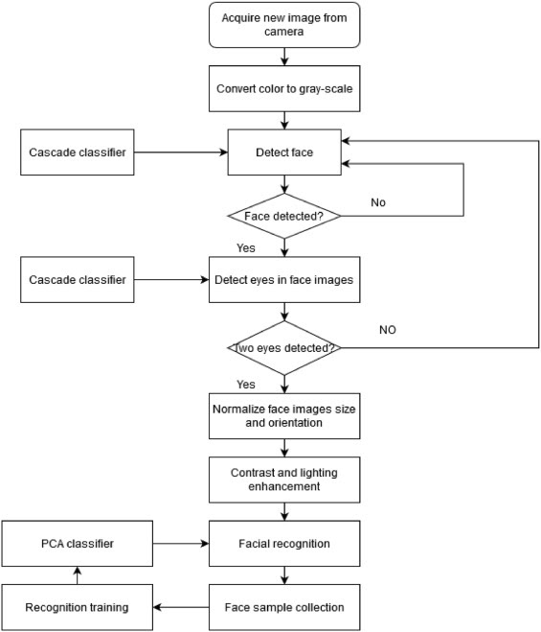
Methodology Used

Slide 13
Methodology used
Smart card scanner
In the field of technology this is a new thing introduced and it is very safe and easy to implement, But the use is limited to only payment gateways or visiting websites, we are using it for authentication of a user in a working place. For the login purpose the need of entering a username is tried to replace with scanning a QR code.
The QR code will contain a randomly generated 32 character secret-key considered as a username (at least 32 characters) which will then be encrypted using a symmetric key algorithm and then be transformed into a QR.

Slide 14
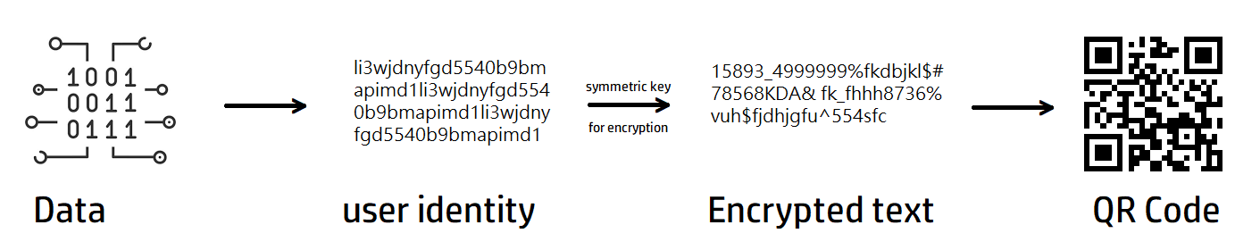
Methodology used
Generating QR Code

Slide 15
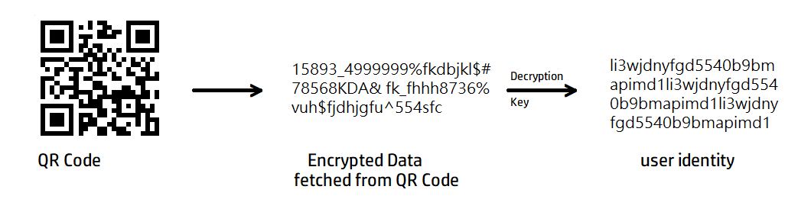
Methodology Used
Scanning QR code
For the scanning mechanism, QR is being scanned and data is being fetched in the QR. The data fetched is in the form of Encrypted text which will be decrypted using the decryption key. The final data will be used as username.

Slide 16
References
Image based face detection and recognition
https://arxiv.org/ftp/arxiv/papers/1302/1302.6379.pdf
K.C. Paul, S Aslan
An Improved Real-Time Face Recognition System at Low Resolution Based on Local Binary Pattern Histogram Algorithm and CLAHE
Optics and Photonics Journal, 11 (April 2021), pp. 63-78
https://www.researchgate.net/publication/350764238_An_Improved_Real-Time_Face_Recognition_System_at_Low_Resolution_Based_on_Local_Binary_Pattern_Histogram_Algorithm_and_CLAHE

Slide 17
References
Samiksha Malhotra, Vaibhav Aggarwal, Himanshu Mangal
Preeti Nagrath and Rachna Jain “Comparison between Attendance System implemented through Haar Cascade Classifier and Face Recognition Library
https://www.researchgate.net/publication/348605656_Comparison_between_attendance_system_implemented_through_haar_cascade_classifier_and_face_recognition_library
Anirudha b shetty, Bhoomika, Deeksha, Jeevan Rebeiro, ramyashree
Facial Recognition using Haar Cascade and LBP Classifiers
https://www.sciencedirect.com/science/article/pii/S2666285X21000728

